Slide 1

FRUIT DETECTION
.

Slide 2
ABSTRACT
*Fruit recognition from images using deep learning.......
.ABSTRACT:
* In this project we introduce a new,high-quality,dataset of a images containing fruits.we also present the results of some numerical experiment for training a neuralnetwork todetect fruits.we discuss the reason why we choose to use fruits in this project by proposing a few applications that could use such classifier.one of the majorquality of grading fruits is its appearance.appearance is effects the marketing and choice of consumer.colour,texture,size,shape,are used to find quality of fruit.

Slide 3
KEY WORDS
KEYWORDS:
1.Deep learning
2.Object recognition
3.Computer vision
4.fruits dataset
5.image processing

Slide 4
INTRODUCTION
* The aim of this project is to propose a new dataset of images containing popular fruits.the dataset was named fruits-360 and can be downloaded from the addresses pointed by references [21] and [22]21 the set contains 90483 images of 131 fruits and vegetables and it is constantly updated with the images of new fruits and vegetables as soon as the authors have accesses to them.
* Having a high-quality datasets is essesntial for obtaining a good classifier.most of the existing datasets with images both the object of the noisy background.this could lead to cases where the changing background will lead to the incorrect classification of the object.

Slide 5
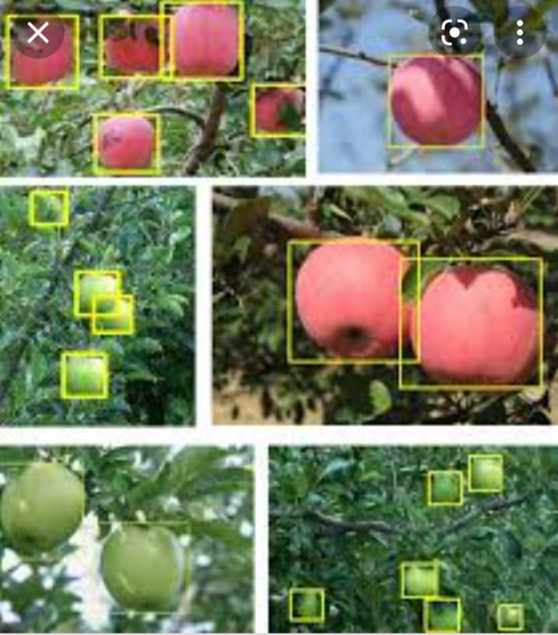
FRUIT DETECTION IMAGE

Slide 6
ROBOFLOW
ROBOFLOW:
*makes managing, preprocessing, augmenting, and versioning datasets for computer vision seamless.Developers reduce 50% of their code when using Roboflow's workflow, automate annotation quality assurance, save training time, and increase model reproducibility.

Slide 7
OVERVIEW
*he Fruits dataset is an image classification dataset of various fruits against white backgrounds from various angles, originally open sourced by GitHub user horea. This is a subset of thatfull dataset.

Slide 8
DEEP LEARNING
In the area of image recognition and classification, the most successful results were obtained using artificial neural networks .
*These networksform the basis for most deep learning models.*Deep learning is a class of machine learning algorithms that use multiple layers that contain nonlinear processing units.
*Each level learns totransform its input data into a slightly more abstract and composite representation.
*Deep neural networks have managed to outperform othermachine learning algorithms.
*They also achieved the first superhuman pattern recognition in certain domains .
*This is further reinforced by the factthat deep learning is considered as an important step towards obtainingStrong AI.
*Secondly, deep neural networks - specifically convolutional neural networks - have been proved to obtain great results in the field of imagerecognition.
*In the rest of this section we will briefly describe some models of deepartificial neural networks along with some results for some related problems

